Slide 1


WarpGuard
The AI Guardian for Avalanche Warp Messaging
Team Igris
Shivamani Yamana
Srinivas Mandula

Slide 2

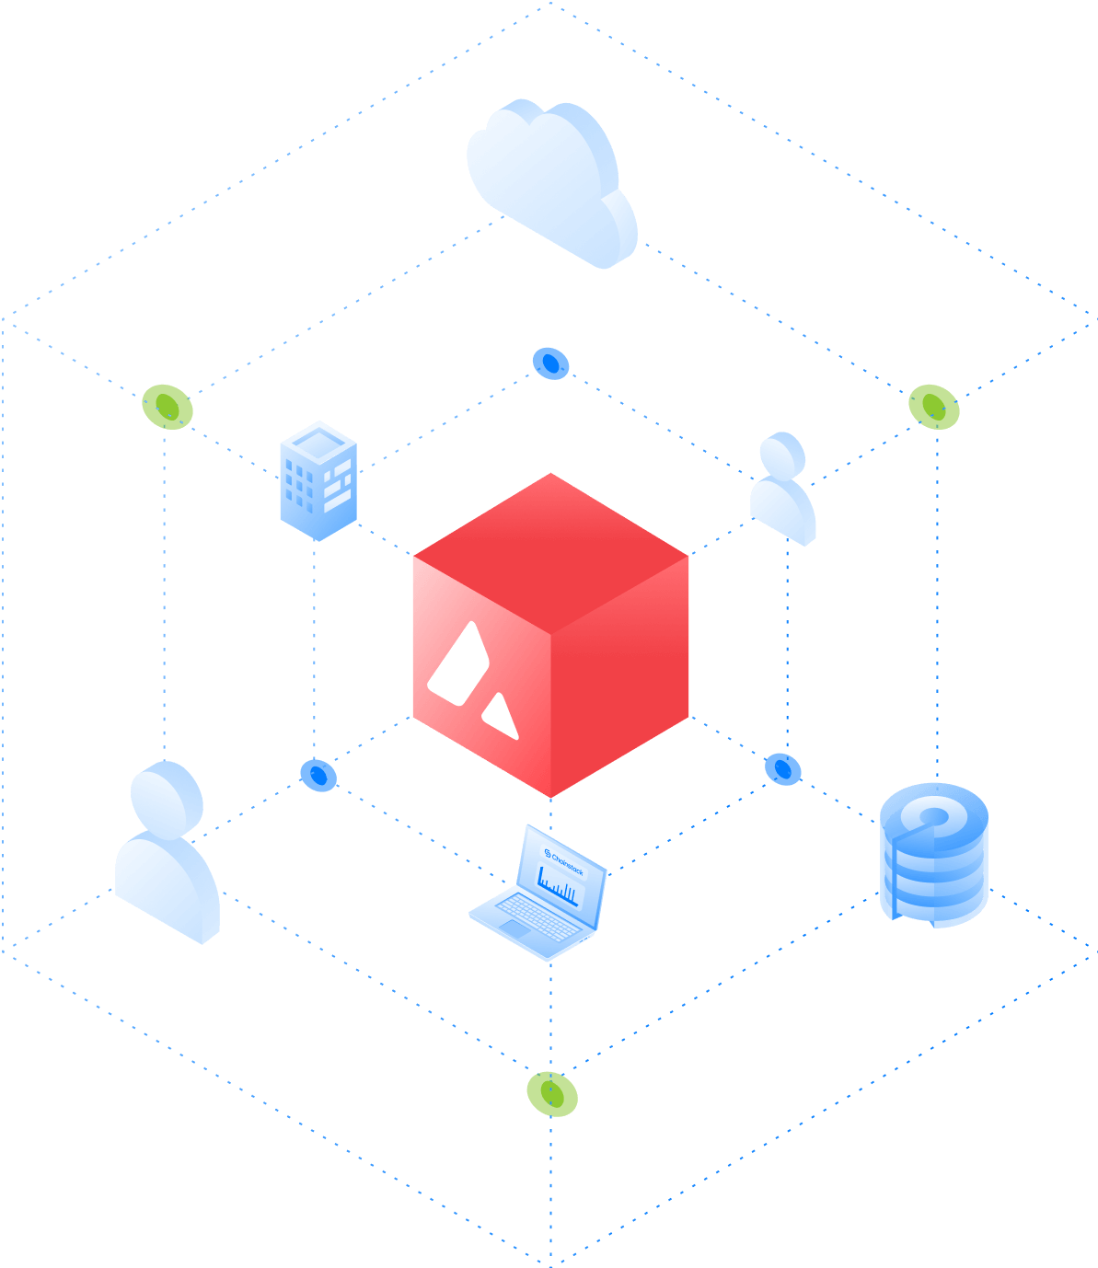
The Problem:
Security is Siloed.
Blockchain networks today suffer from siloed and reactive security.
Malicious actors flagged on one subnet can easily evade detection by switching identities or moving to another.
In ecosystems like Avalanche, this lack of cross-chain threat intelligence creates a game of whack-a-mole—allowing threats to persist, spread, and erode trust across the network

Slide 3


WarpGuard is the first AI-powered security layer for Avalanche Warp Messaging, enabling real-time, cross-chain content moderation.
It uses advanced language models to detect malicious content as it's submitted, then instantly shares threat intelligence across subnets via Warp Messaging. This creates a unified security layer so if a threat is detected once, it's blocked everywhere.
One detection. Ecosystem-wide protection.
Our Solution: WarpGuard
The AI Guardian for Avalanche Warp Messaging

Slide 4
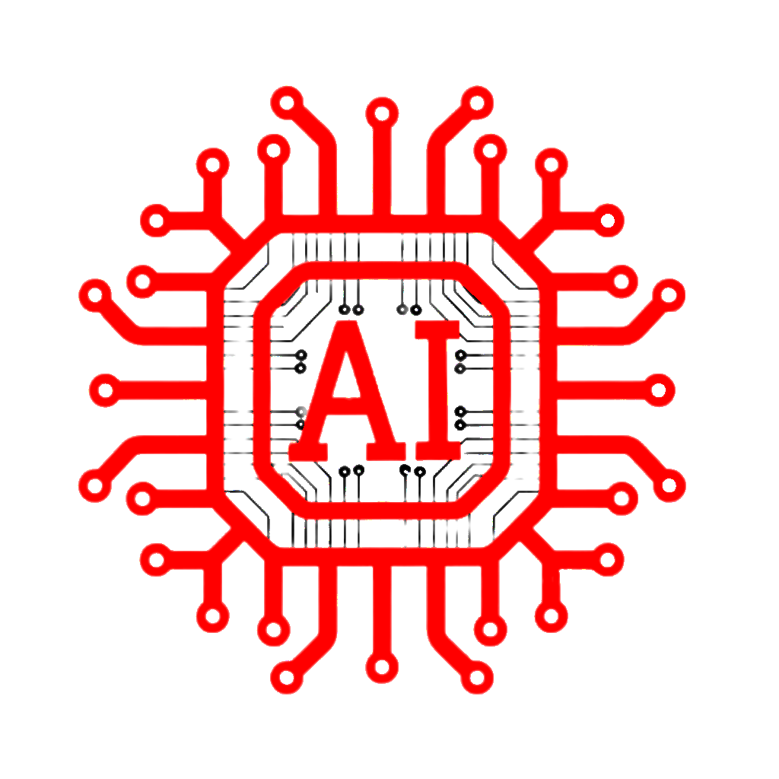
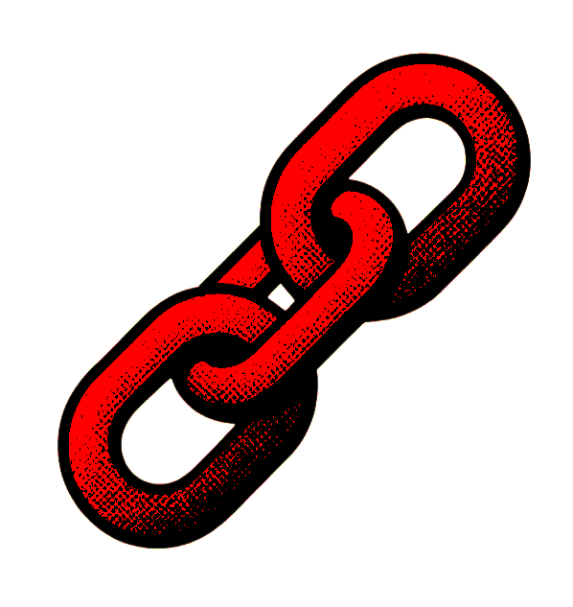
Three Major Innovations
Sub-second
AI threat detection using low-latency intent classification models
Native-Interchain Communication through Avalanche Warp Messaging
Automated Universal Protection via 24/7 threat intelligence monitoring

Slide 5
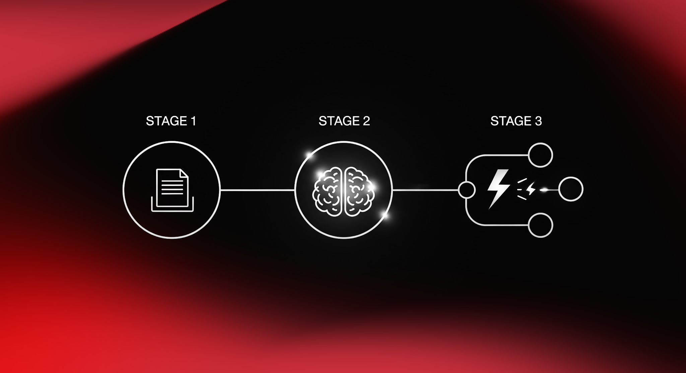
How It Works?
User submits content on App Subnet
(eg. metadata,urls…)
Security Subnet instantly calls python backend to analyse the intent
If malicious, triggers A warp message in milliseconds

Slide 6

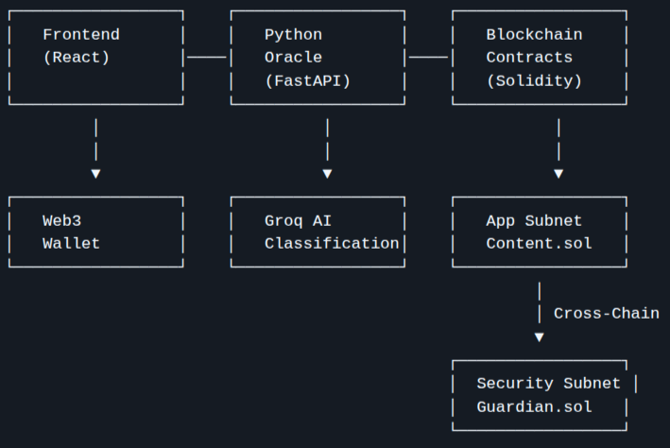
Architecture of WarpGuard

Slide 7
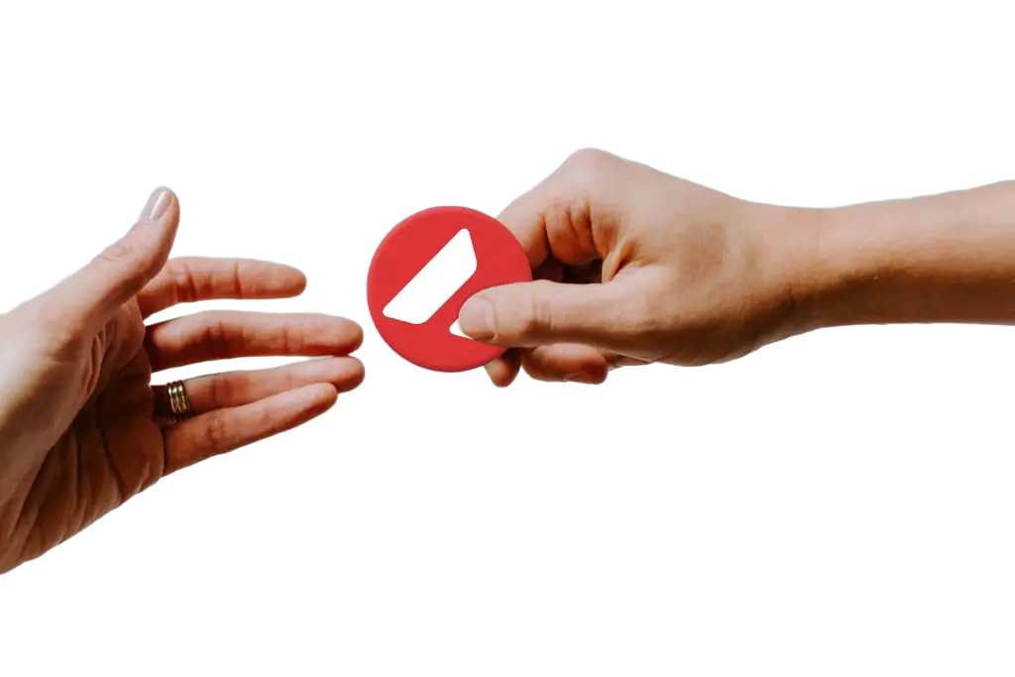
The Opportunity
Web3 market projected to hit $100B by 2034, but trust is a major challenge.
Avalanche has 326+ Layer L1’s live, each subnet represents a community we need to protect.
We're building a DePIN to secure them all.

Slide 8
Our Project Scope
Phase 1: Text content moderation MVP (Completed)
Phase 2: Offload AI classification to Chainlink Functions or DONs for scalability and feasibility, using GitHub Gists to securely manage secrets
Phase 3: Enable multimodal content moderation (e.g., text, image) on-chain
Phase 4: Launch a tokenized, decentralized structure to make WarpGuard a truly community-driven security protocol

Slide 9
Trust is the foundation.
We’re building it!
– Team Igris –

